Slide 1

CGMH: Constrained Sentence Generation by Metropolis-Hastings Sampling
Ning Miao, Hao Zhou, Lili Mou, Rui Yan, Lei Li

Slide 2

Content
Motivation
Constrained generation is useful
Constrained generation is difficult for current methods
Introduction
Metropolis-Hastings sampling
Method
Stationary distribution
Proposal
Accept/Reject
Experiment
Keywords2Sentence generation
Unsupervised paraphrase generation
Sentence correction

Slide 3
Motivation
We often need to add constrains to sentence generation.
Hard constrains (eg. keyword2sentence)
Juice -> Brand natural juice, specially made for you

Slide 4
Motivation
We often need to add constrains to sentence generation.
Hard constrains (eg. keyword2sentence)
Juice -> Brand natural juice, specially made for you
Soft constrains (eg. paraphrase)
The movie is a great success -> It is one of my favorite movies

Slide 5
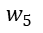
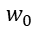
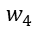
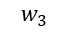
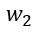
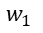
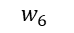
Motivation
It’s difficult to add constraints to sequential language models.
…
$$w_{0}$$
$$w_{1}$$
$$w_{2}$$
$$w_{3}$$
$$w_{4}$$
$$w_{5}$$
$$w_{6}$$

Slide 6
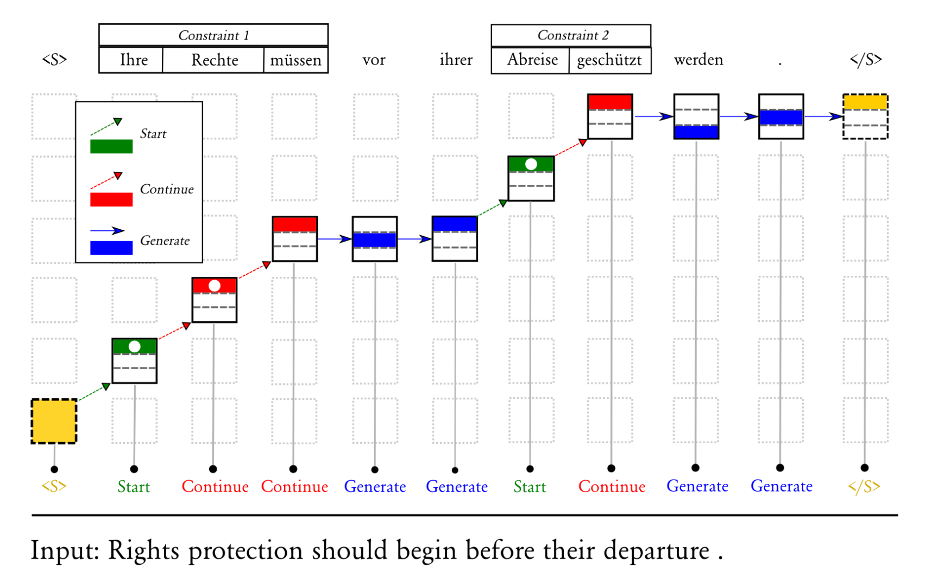
Motivation
Methods dedicated for constrained sentence generation can only handle a specific kind of constraints.
- Grid Beam Search(GBS)¹
- Constrained Beam Search(CBS)²

Slide 7
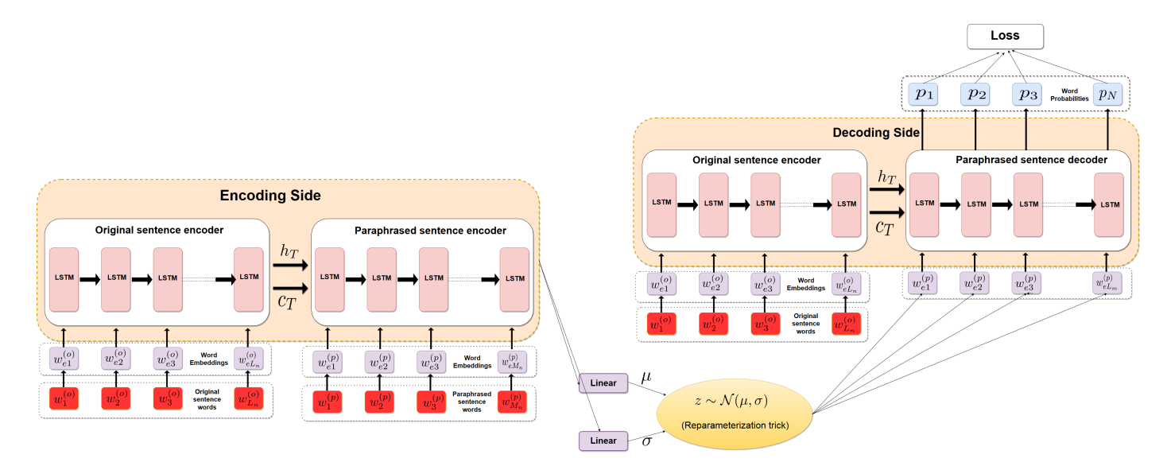
Motivation
Methods dedicated for constrained sentence generation can only handle a specific kind of constraints.
- VAE-SVG³

Slide 8
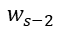
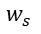
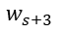
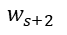
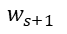
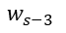
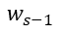
Motivation
Current models don’t perform well
LSTM w/ sep-B/F⁴ generates independent backward and forward sequences from the given word.
Eg: demand -> this is what it does in demand is very necessary .
Backward
Forward
$$w_{s−3}$$
$$w_{s−2}$$
$$w_{s−1}$$
$$w_{s}$$
$$w_{s+1}$$
$$w_{s+2}$$
$$w_{s+3}$$

Slide 9
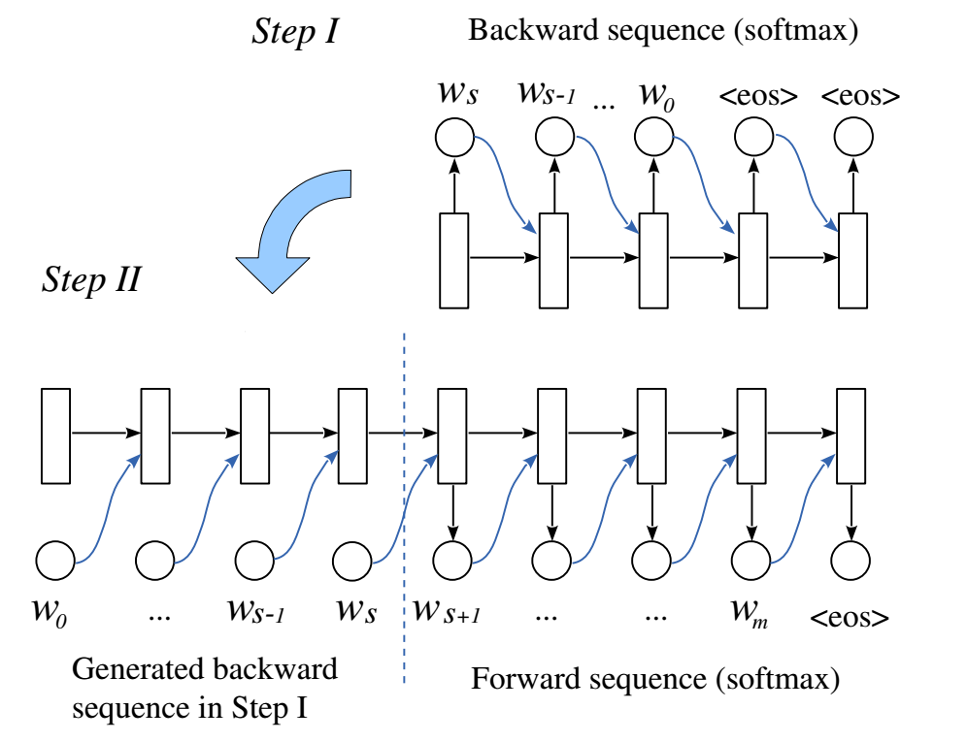
Motivation
Current models don’t perform well
LSTM w/ asyn-B/F⁴ first generates the first half of a sentence and then generates another half conditioned on the first half.
Eg: player -> The best name of the player is not making a year .

Slide 10
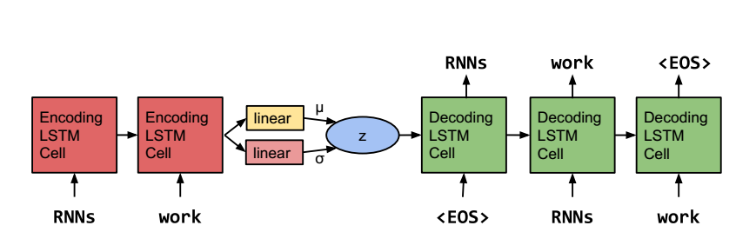
Motivation
Current models don’t perform well
VAE⁵ - We can perform paraphrasing by
Encode a sentence into a distributional representation
Add some noise to the representation
then decoding the disturbed representation.
Unfortunately, the generated sentences of this method is of low quality.

Slide 11
Motivation
We need a practical method for sentence generation under both hard and soft constraints! So we propose Constrained Generation by Metropolis-Hastings sampling (CGMH).

Slide 12
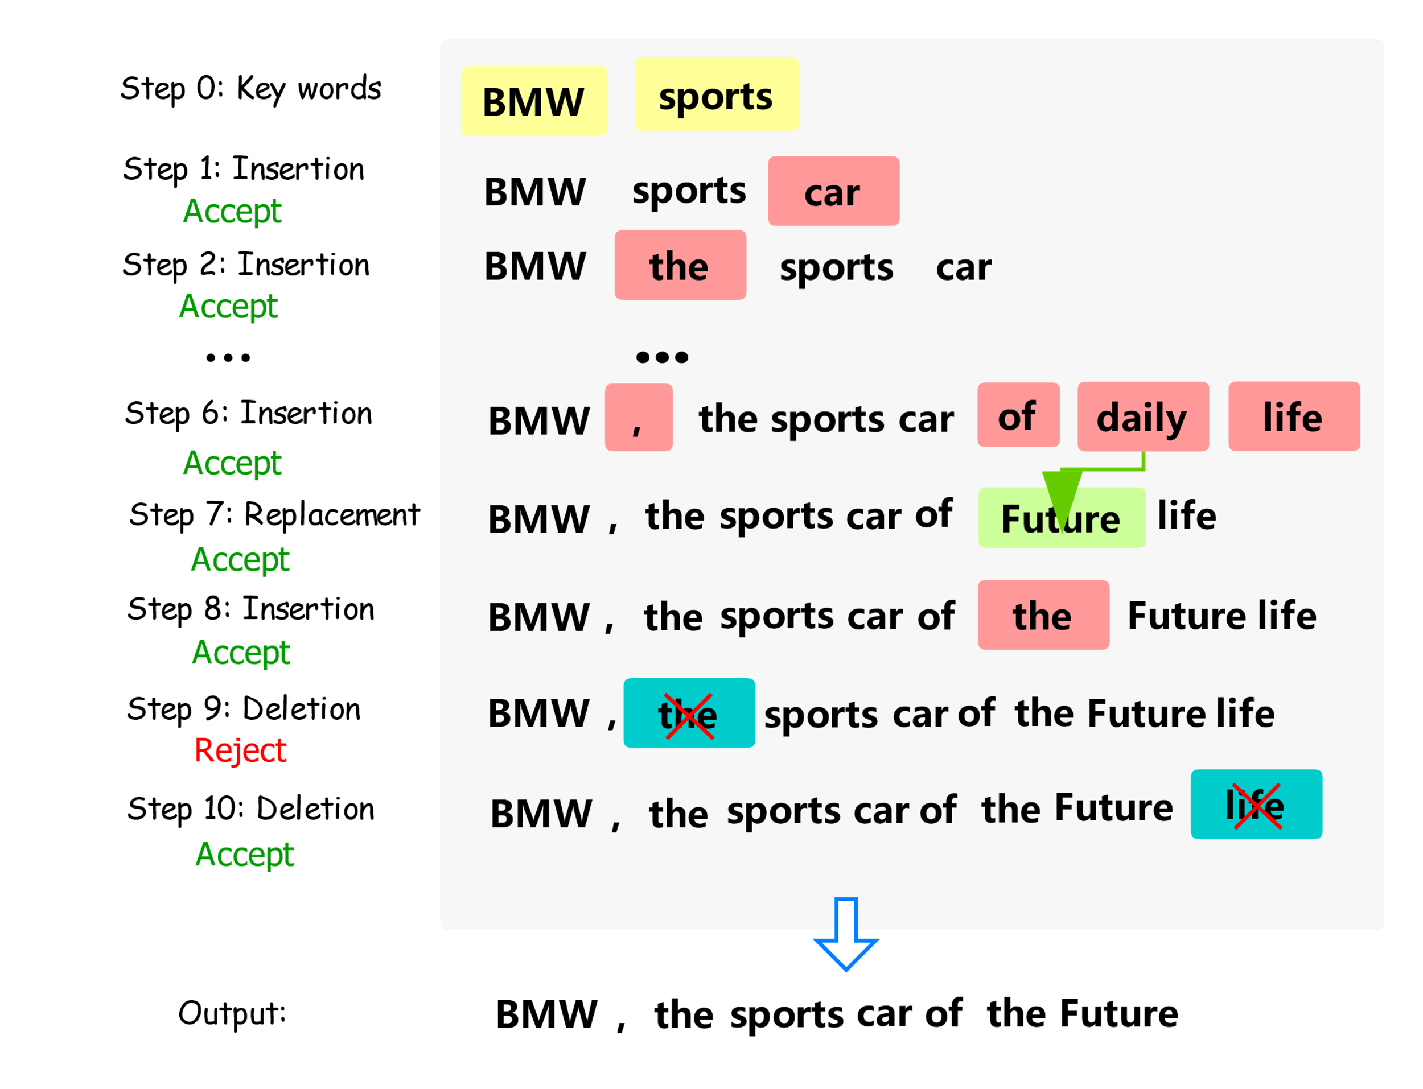
Introduction
The main idea of CGMH is performing Metropolis-Hastings sampling directly in sentence space. The figure on the right illustrates CGMH by an example of generating advertisement from keywords.

Slide 13
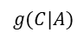
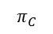
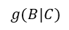
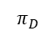
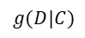
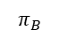
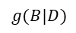
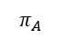
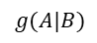
Introduction - Metropolis-Hastings Sampling
Metropolis-Hastings(MH) sampling is a 2-step Markov Chain Monte Carlo (MCMC) algorithm
$$π_{A}$$
$$π_{B}$$
A
$$g(A|B)$$
B
$$g(C|A)$$
$$g(B|C)$$
$$g(B|D)$$
C
D
$$g(D|C)$$
$$π_{C}$$
$$π_{D}$$

Slide 14
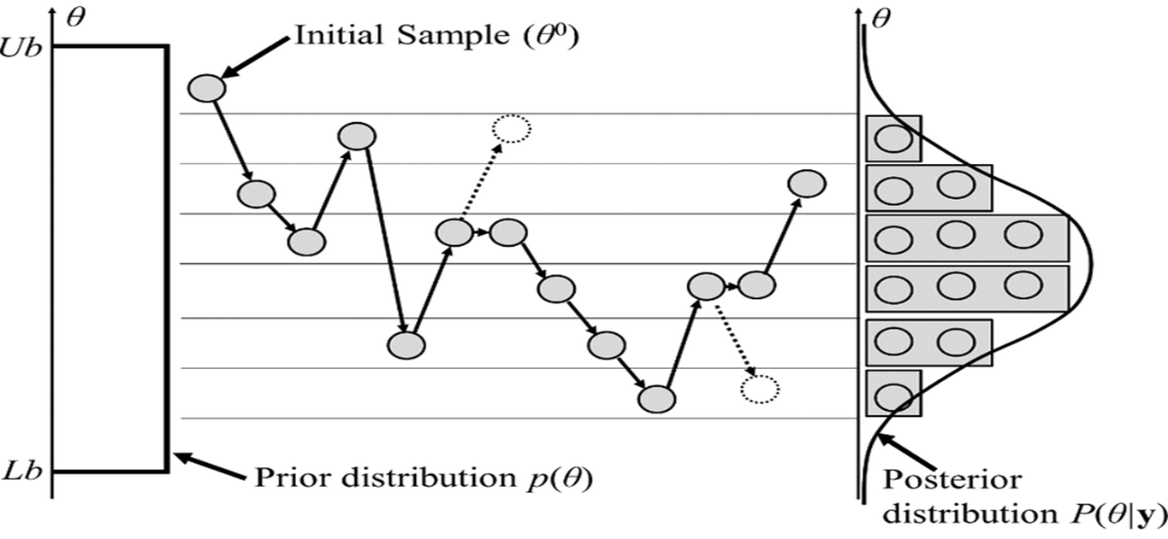
Introduction - Metropolis-Hastings Sampling
Metropolis-Hastings(MH) sampling is a 2-step Markov Chain Monte-Carlo (MCMC) algorithm
MH first proposes a transition, and then accepts or rejects the transition. (Gibbs sampling is a special case of MH sampling which always accepts transitions.)
$$π_{A}$$
$$π_{B}$$
A
$$g(A|B)$$
B
$$g(C|A)$$
$$g(B|C)$$
$$g(B|D)$$
C
D
$$g(D|C)$$
$$π_{C}$$
$$π_{D}$$

Slide 15

Method – Stationary Distribution
We set the stationary distribution as:
$$π\left(x\right) =P\left(x\right)·P_{C}\left(x\right)$$

Slide 16
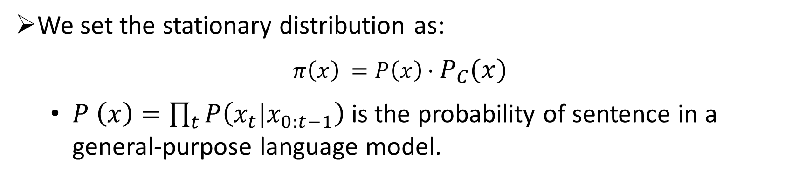
Method – Stationary Distribution
We set the stationary distribution as:
$$π\left(x\right) =P\left(x\right)·P_{C}\left(x\right)$$
$P \left(x\right)=\prod_{t}{P\left(x_{t}|x_{0:t−1}\right) }$is the probability of sentence in a general-purpose language model.

Slide 17
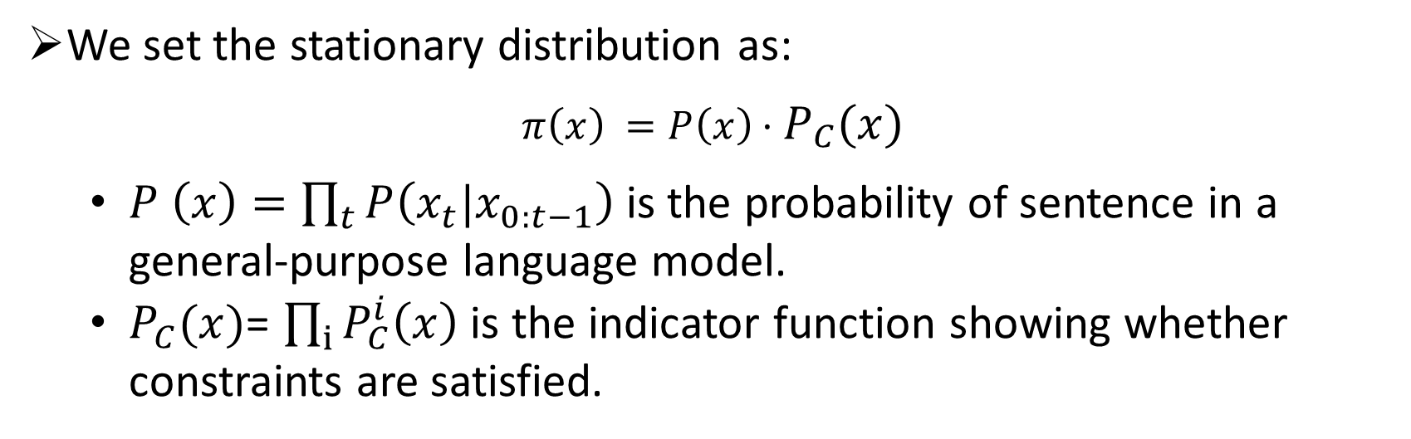
Method – Stationary Distribution
We set the stationary distribution as:
$$π\left(x\right) =P\left(x\right)·P_{C}\left(x\right)$$
$P \left(x\right)=\prod_{t}{P\left(x_{t}|x_{0:t−1}\right) }$is the probability of sentence in a general-purpose language model.
$P_{C}(x)$= $\prod_{i}{P_{C}^{i}\left(x\right)}$ is the indicator function showing whether constraints are satisfied.

Slide 18
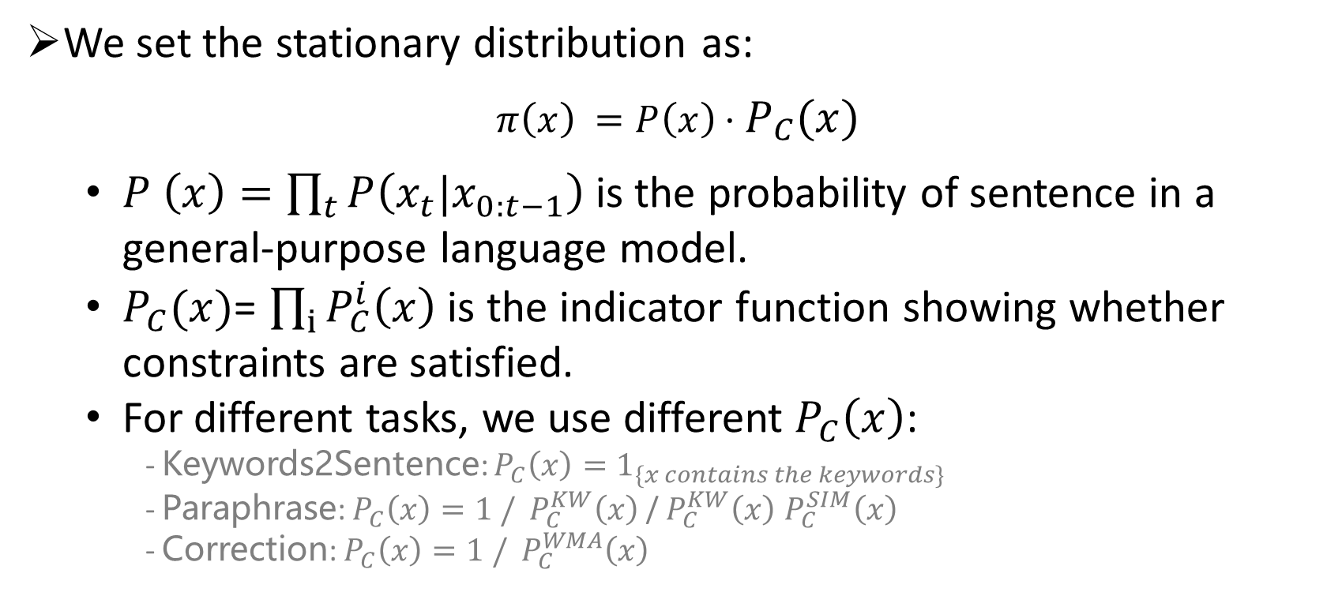
Method – Stationary Distribution
We set the stationary distribution as:
$$π\left(x\right) =P\left(x\right)·P_{C}\left(x\right)$$
$P \left(x\right)=\prod_{t}{P\left(x_{t}|x_{0:t−1}\right) }$is the probability of sentence in a general-purpose language model.
$P_{C}(x)$= $\prod_{i}{P_{C}^{i}\left(x\right)}$ is the indicator function showing whether constraints are satisfied.
For different tasks, we use different $P_{C}\left(x\right)$:
- Keywords2Sentence: $P_{C}\left(x\right)=1_{\{x contains the keywords\}}$
- Paraphrase: $P_{C}\left(x\right)=1 /$ ${ P}_{C}^{KW}\left(x\right)$ /${ P}_{C}^{KW}\left(x\right)$ $P_{C}^{SIM}\left(x\right)$
- Correction: $P_{C}\left(x\right)=1 / P_{C}^{WMA}\left(x\right)$

Slide 19
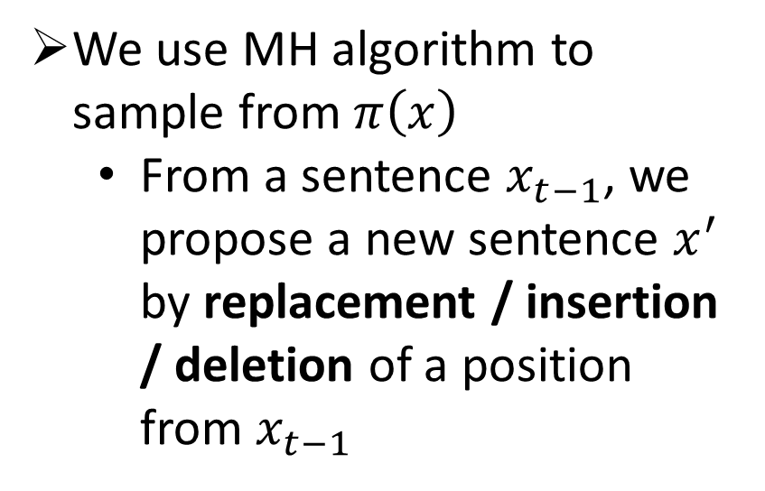
Method – Proposal
We use MH algorithm to sample from$π\left(x\right)$
From a sentence $x_{t−1}$, we propose a new sentence $x^{′}$ by replacement / insertion / deletion of a position from $x_{t−1}$

Slide 20
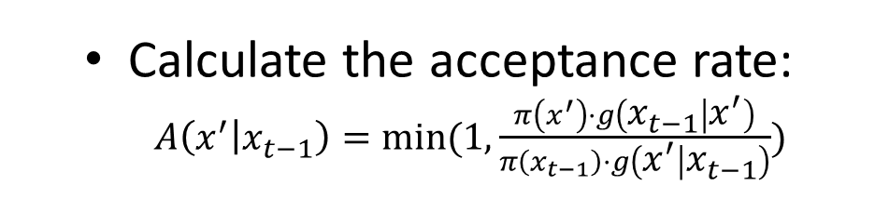
Method –Accept/Reject
Calculate the acceptance rate:
$A\left(x^{′} | x_{t−1}\right)=min⁡(1, \frac{π\left(x^{′}\right)·g\left(x_{t−1} | x^{′}\right)}{π\left(x_{t−1}\right)·g\left(x^{′} | x_{t−1}\right)})$

Slide 21
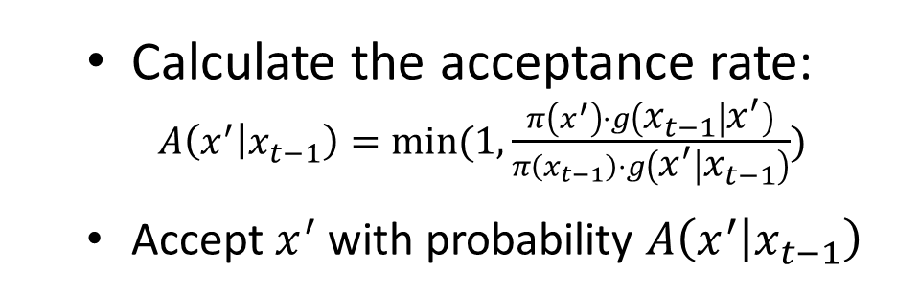
Method –Accept/Reject
Calculate the acceptance rate:
$A\left(x^{′} | x_{t−1}\right)=min⁡(1, \frac{π\left(x^{′}\right)·g\left(x_{t−1} | x^{′}\right)}{π\left(x_{t−1}\right)·g\left(x^{′} | x_{t−1}\right)})$
Accept $x^{′}$ with probability $A\left(x^{′} | x_{t−1}\right)$

Slide 22
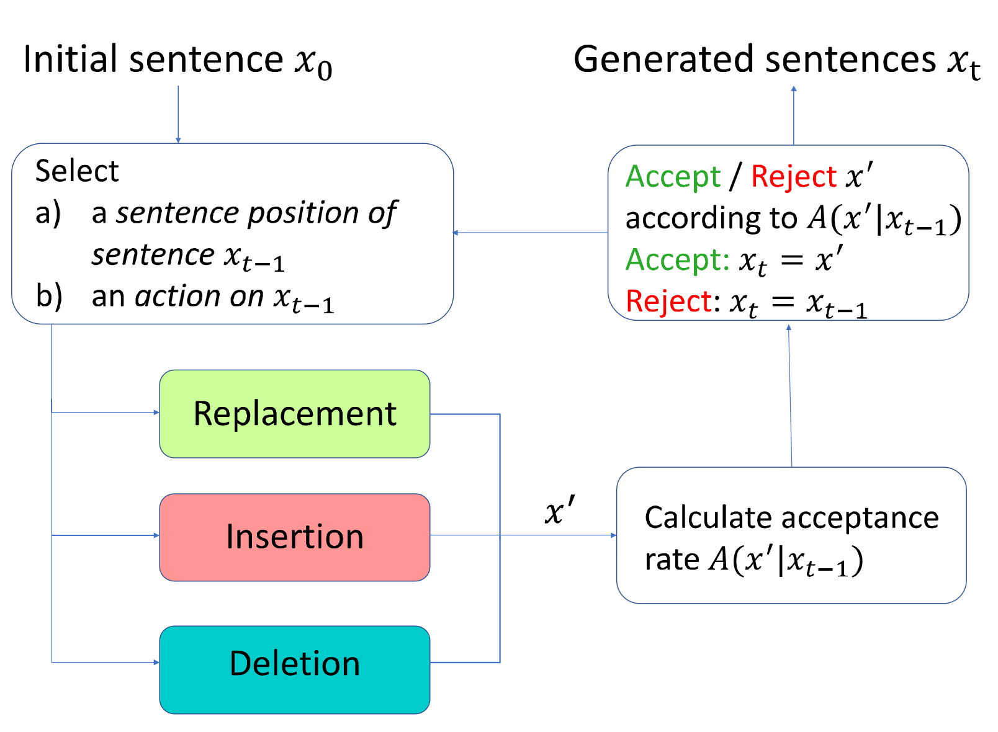
Method –Accept/Reject
Calculate the acceptance rate:
$A\left(x^{′} | x_{t−1}\right)=min⁡(1, \frac{π\left(x^{′}\right)·g\left(x_{t−1} | x^{′}\right)}{π\left(x_{t−1}\right)·g\left(x^{′} | x_{t−1}\right)})$
Accept $x^{′}$ with probability $A\left(x^{′} | x_{t−1}\right)$

Slide 23
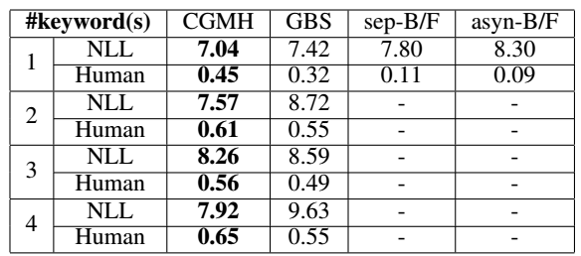
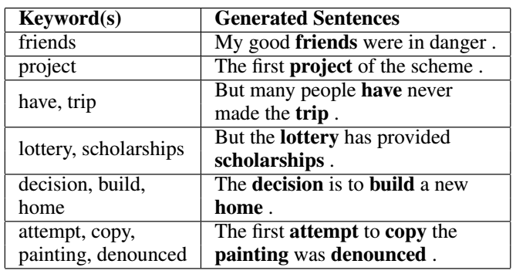
Experiment
We test CGMH on three different tasks.

Slide 24
Experiment
We test CGMH on three different tasks.
Keywords2Sentence Generation
Aim: To generate fluent sentences containing the given set of words.
Dataset: A subset of One-Billion-Word Corpus (5M)

Slide 25
Experiment
We test CGMH on three different tasks.
Keywords2Sentence Generation
Aim: To generate fluent sentences containing the given set of words.
Dataset: A subset of One-Billion-Word Corpus (5M)
Unsupervised Paraphrase Generation
Aim: To generate sentences with similar meaning of the given one.
Dataset: Quora(140k pairs of paraphrase sentences)

Slide 26
Experiment
We test CGMH on three different tasks.
Keywords2Sentence Generation
Aim: To generate fluent sentences containing the given set of words.
Dataset: A subset of One-Billion-Word Corpus (5M)
Unsupervised Paraphrase Generation
Aim: To generate sentences with similar meaning of the given one.
Dataset: Quora(140k pairs of paraphrase sentences)
Sentence Correction
Aim: To correct the errors in the given sentence.
Dataset: A subset of One-Billion-Word Corpus (5M, base language model) and JFLEG(1501 sentences, for test only)

Slide 27
Experiment - Keywords2Sentence Generation
To generate sentences from a variable number of keywords, we simply start sampling from the given keywords. Experimental results show that CGMH outperforms previous work in both NLL and human evaluations.

Slide 28
Experiment - Keywords2Sentence Generation
To generate sentence from a variable number of keywords, we simply start sampling from the given keywords. Experimental results show that CGMH outperforms previous work in both NLL and human evaluations.

Slide 29
Experiment - Keywords2Sentence Generation
To generate sentence from a variable number of keywords, we simply start sampling from the given keywords. Experimental results show that CGMH outperforms previous work in both NLL and human evaluations.
Keyword(s) | Generated Sentences
friends | My good friends were in danger .
project | The first project of the scheme .
have, trip | But many people have never made the trip .
lottery, scholarships | But the lottery has provided scholarships.
decision, build, home | The decision is to build a new home.
attempt, copy, painting, denounced | The first attempt to copy the painting was denounced.

Slide 30
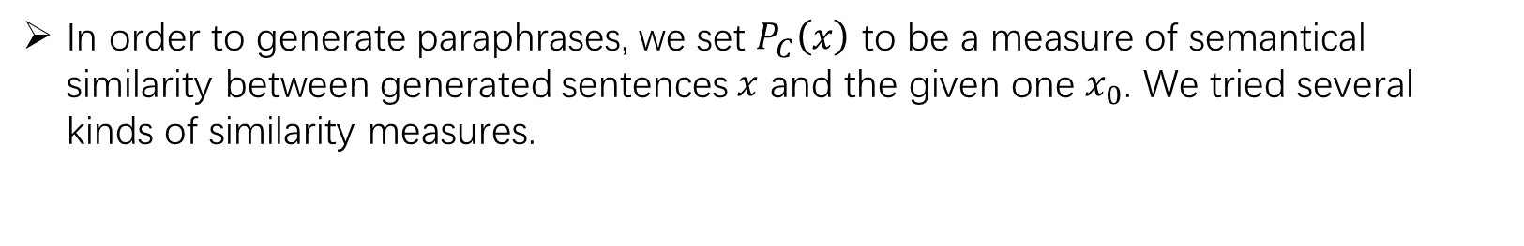
Experiment - Unsupervised Paraphrase Generation
In order to generate paraphrases, we set $P_{C}\left(x\right)$ to be a measure of semantical similarity between generated sentences $x$ and the given one $x_{0}$. We tried several kinds of similarity measures.

Slide 31
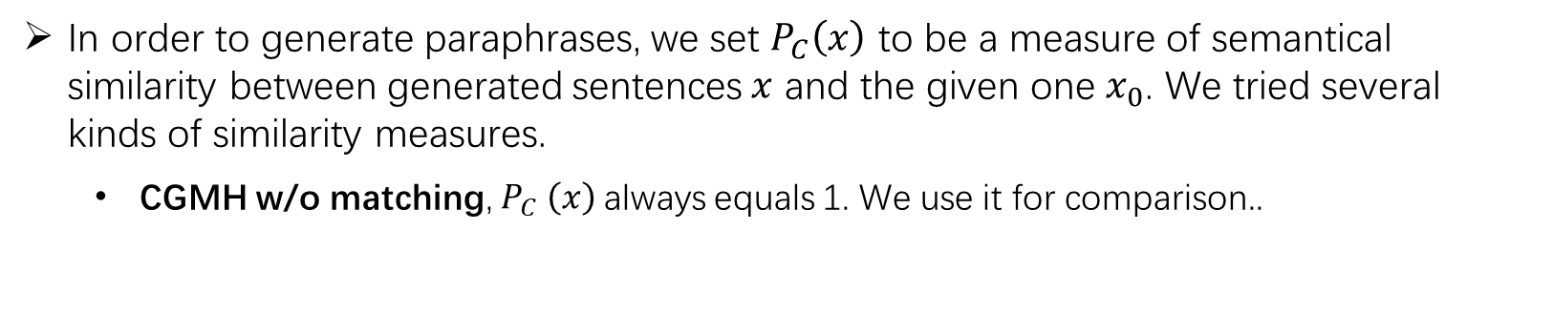
Experiment - Unsupervised Paraphrase Generation
In order to generate paraphrases, we set $P_{C}\left(x\right)$ to be a measure of semantical similarity between generated sentences $x$ and the given one $x_{0}$. We tried several kinds of similarity measures.
CGMH w/o matching, $P_{C} \left(x\right)$always equals 1. We use it for comparison..

Slide 32
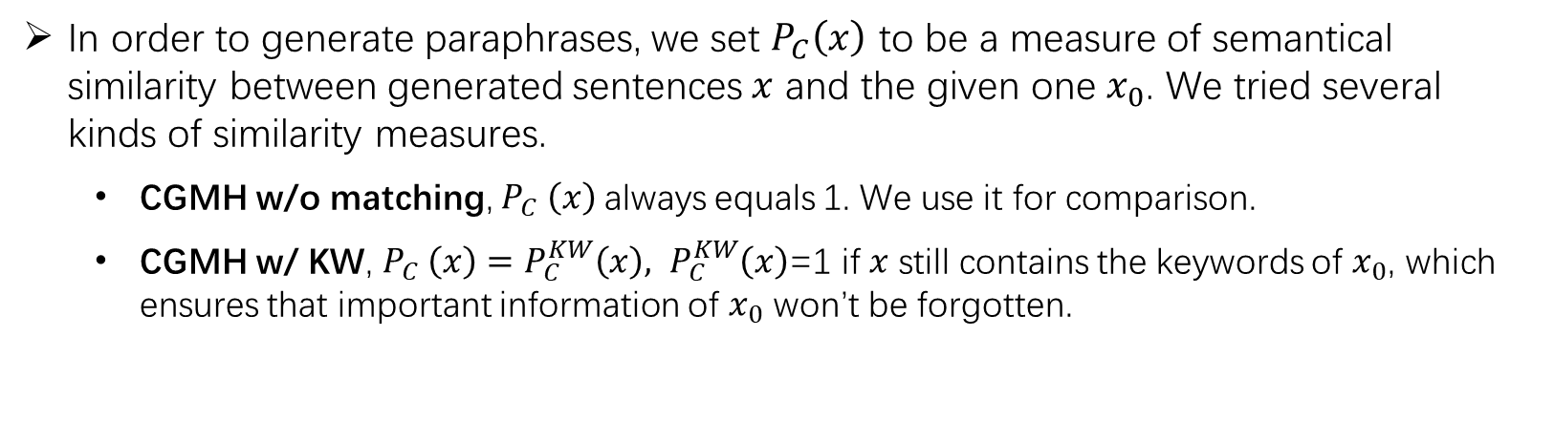
Experiment - Unsupervised Paraphrase Generation
In order to generate paraphrases, we set $P_{C}\left(x\right)$ to be a measure of semantical similarity between generated sentences $x$ and the given one $x_{0}$. We tried several kinds of similarity measures.
CGMH w/o matching, $P_{C} \left(x\right)$always equals 1. We use it for comparison.
CGMH w/ KW, $P_{C} \left(x\right)=P_{C}^{KW}\left(x\right), P_{C}^{KW}\left(x\right)$=1 if $x$ still contains the keywords of $x_{0}$, which ensures that important information of $x_{0}$ won’t be forgotten.

Slide 33
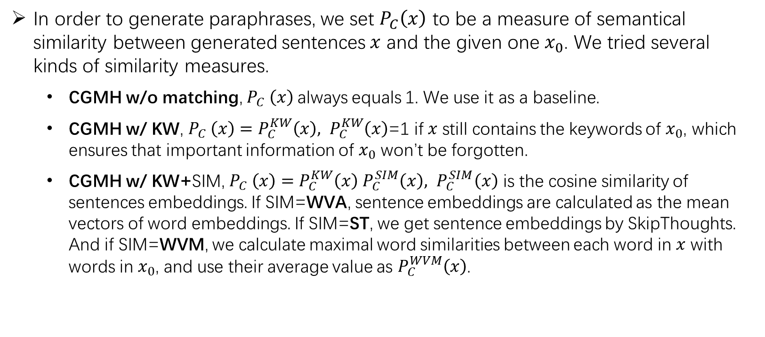
Experiment - Unsupervised Paraphrase Generation
In order to generate paraphrases, we set $P_{C}\left(x\right)$ to be a measure of semantical similarity between generated sentences $x$ and the given one $x_{0}$. We tried several kinds of similarity measures.
CGMH w/o matching, $P_{C} \left(x\right)$always equals 1. We use it as a baseline.
CGMH w/ KW, $P_{C} \left(x\right)=P_{C}^{KW}\left(x\right), P_{C}^{KW}\left(x\right)$=1 if $x$ still contains the keywords of $x_{0}$, which ensures that important information of $x_{0}$ won’t be forgotten.
CGMH w/ KW+SIM, $P_{C} \left(x\right)=P_{C}^{KW}\left(x\right)$ $P_{C}^{SIM}\left(x\right), { P}_{C}^{SIM}\left(x\right)$ is the cosine similarity of sentences embeddings. If SIM=WVA, sentence embeddings are calculated as the mean vectors of word embeddings. If SIM=ST, we get sentence embeddings by SkipThoughts. And if SIM=WVM, we calculate maximal word similarities between each word in $x$ with words in $x_{0}$, and use their average value as $P_{C}^{WVM}\left(x\right)$.

Slide 34
Experiment - Unsupervised Paraphrase Generation
CGMH is the first unsupervised model to achieve comparable results with supervised models.

Slide 35
Experiment - Unsupervised Paraphrase Generation
CGMH is the first unsupervised model to achieve comparable results with supervised models.
Examples
1,what ‘s the best plan to lose weight ->
what ‘s the best way to slim down quickly
2. how should i control my emotion ->
how do i control my anger
3. why do my dogs love to eat tuna fish ->
why do my dogs like to eat raw tuna and raw fish

Slide 36
Experiment - Unsupervised Error Correction
CGMH outperforms some of the supervised models trained on large parallel corpus.

Slide 37
Experiment - Unsupervised Error Correction
CGMH outperforms some of the supervised models trained on large parallel corpus.
Erroneous sen1 | Even if we are failed , we have to try to get a new things .
Reference sen1 | Even if we all failed , we have to try to get new things .
Output sen1 | Even if we are failing , we have to try to get some new things ..
Erroneous sen2 | In the world oil price very high right now .
Reference sen2 | In today ‘s world , oil prices are very high right now .
Output sen2 | In the world , oil prices are very high right now .

Slide 38
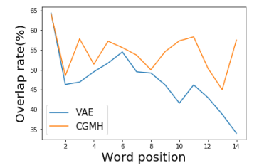
Analysis
Why CGMH outperforms sequential models?
RNN can be thought of as an autoregressive Bayesian network generating words conditioned on previous ones. Hence error will accumulate during generation.

Slide 39
Analysis
Why CGMH outperforms sequential models?
RNN can be thought of as an autoregressive Bayesian network generating words conditioned on previous ones. Hence error will accumulate during generation.
CGMH doesn’t generate sequentially, so error won’t accumulate.

Slide 40
Analysis
Why CGMH outperforms sequential models?
RNN can be thought of as an autoregressive Bayesian network generating words conditioned on previous ones. Hence error will accumulate during generation.
CGMH doesn’t generate sequentially, so error won’t accumulate.
At the same time, CGMH has the ability of self-correction. Please refer to the part of sentence correction.

Slide 41
Reference
[1] Hokamp, C., and Liu, Q. 2017. Lexically constrained decoding for sequence generation using grid beam search. In ACL.
[2] Anderson, P.; Fernando, B.; Johnson, M.; and Gould, S. 2017. Guided open vocabulary image captioning with constrained beam search. In EMNLP.
[3] Gupta, A.; Agarwal, A.; Singh, P.; and Rai, P. 2017. A deep generative framework for paraphrase generation. arXiv preprint arXiv:1709.05074.
[4] Mou, L.; Yan, R.; Li, G.; Zhang, L.; and Jin, Z. 2015. Backward and forward language modeling for constrained sentence generation. arXiv preprint arXiv:1512.06612.
[5] Bowman, S. R.; Vilnis, L.; Vinyals, O.; Dai, A.; Jozefowicz, R.; and Bengio, S. 2016. Generating sentences from a continuous space. In CoNLL.
[6] Li, Z.; Jiang, X.; Shang, L.; and Li, H. 2017. Paraphrase generation with deep reinforcement learning. arXiv preprint arXiv:1711.00279.
[7] Junczys-Dowmunt, M., and Grundkiewicz, R. 2016. Phrasebased machine translation is state-of-the-art for automatic grammatical error correction. arXiv preprint arXiv:1605.06353.
[8] Felice, M.; Yuan, Z.; Andersen, Ø. E.; Yannakoudakis, H.; and Kochmar, E. 2014. Grammatical error correction using hybrid systems and type filtering. In CoNLL.
[9] Napoles, C.; Sakaguchi, K.; Post, M.; and Tetreault, J. 2015. Ground truth for grammatical error correction metrics. In ACL.

Slide 42

THANKS.

